Slide 1

Online Food Ordering & Table Reservation System

Slide 2
Presented By
K.Meghana Chowdary | 316126510147
K.Haritha | 316126510149
M.Sri Manjari | 316126510152
M.Naveen | 316126510156
MD.Mehar Naaz | 316126510158
K.Naren Sai Krishna | 316126510164
R.Sree Meghana | 316126510170

Slide 3
Abstract
The application is about the online food ordering and table reservation mechanism of the restaurant "Relish, A Foodie's Paradise".
The application is user-friendly and allows the user to order food by sitting relaxed at their home.
It also allows them to reserve their favorite table in the restaurant ,which cuts down waiting time. So this application thereby improves the revenue of the restaurant since the customer finds this way easy to satisfy their food cravings.
There are different components in the application: User Account, Menu Card, Details,
Table Reservation.
1) Details: This tab provides the address and phone number
of the restaurant for the sake of customer.
2) Menu Card: The menu card presents a variety of food items,
in different cuisines like Mexican, Italian, Chinese, etc.
The customer can customize the items they order.

Slide 4
3) User Account: A user can place order only after logging into his Relish application account.
4) Table Reservation: Customer can know the availability of space, select from the available seatings having different outdoor views.
5) Payment: When the customer chooses what they want to eat, they choose the payment mode:
a)Debit Card b)Credit Card c)Net banking d)Cash on delivery
6) Coupon Code: The customer can enter coupon code they received through their account for discounts.
The coupon codes may be specific to customers, based on how frequently they order.
7) Rating: The application allows customers to rate the food delivery experience for the different categories: 1)taste 2)quality 3)value for money 4)delay of delivery
The user may also give suggestions for the benefit of the restaurant.
Hence the application is beneficial to the customer and also promotes the food business of Relish.

Slide 5
Problem Statement
This project is online “Food ordering and Table reservation” system.
An imaginary restaurant named Relish, is considered in the process of creating this application.
The software enables ordering food from the restaurant. Also one can reserve tables in the restaurant.
The customer need not make an effort to come to Relish. They can relish the scrumptious food ,part of different cuisines by staying at home ,their comfort zone.

Slide 6
5. Also ,the website eliminates the downside of waiting for long time ,at times ,in the process of seeking rich food and great ambience by making the best of both worlds.
6. This is similar to many online food delivery applications seen these days.
7. But the additional feature is table reservation. The magnificent appearance and elaborate user-interface makes the website out of the ordinary.

Slide 7
Existing System
For placing any orders customers have to visit hotels or restaurants to know about food items and then place order and pay.
In this method time and manual work is required.
While placing an order over the phone, customer lacks the physical copy of the menu item.
Lack of visual confirmation that the order was placed correctly.
Every restaurant needs certain employees to take the order over phone or in-person, to offer a rich dining experience and process the payment.
In today’s market, labor rates are increasing day by day making it difficult to find employees when needed.

Slide 8
Proposed system
This online application enables the end users to :
Register online,
Select the food items from the list available,
Order food,
Pay for the order, and
Reserve Table at a specified date and time.
By using this application the work of the waiter is reduced.
This application thus saves the customers time by avoiding long queues at the restaurants.

Slide 9
Anticipated Benefits for the proposed system are:
1. This will minimize the number of employees at the back of the counter.
2. The system will help to reduce labor cost involved.
3. The system will be less probable to make mistake, since it’s a machine.
4. This will avoid long queues at the counter due to the
speed of execution and number of optimum screens to accommodate the maximum throughput.

Slide 10
Hardware Requirements
Processor : Intel Pentium 4 or higher
RAM : 512 MB or higher
Hard-drive space : 60 MB or higher
Internet Connection : 4 Mbps or higher
Controller : Keyboard and a Mouse

Slide 11
Software requirements
Operating System : Windows , Mac, Linux.
Web Technologies : Html, JavaScript, CSS, PHP
Web Server : Wamp
Database : My SQL
Web Browser : IE, Mozilla Firefox or Google Chrome
Browser Configuration : JavaScript must be enabled,
Cookies must be enabled, Pop-up windows must be enabled.

Slide 12
Functional requirements
Table Reservation : User can reserve any table through this application any time and from any where.
Food Ordering : User can also order their favourite food using this application.
Feedback : User can tell his experience for the services provided by giving rating in the “Rate Us” section.

Slide 13
Non-functional requirements
Real time information can be transferred from a website’s
e-menu to a kitchen and cashier through wireless connection.
User interfaces e-menu or digital menu should be user friendly and easy to use.
E-menu on mobile or desktop can consume web services provided by a external server through internet connection.
The system shall provide 100% access reliability.

Slide 14
Non-functional requirements
1.Performance requirements:
The system need to be reliable.
If unable to process the request then appropriate error message.
Web pages are loaded within few seconds.
2.Safety requirements:
The details need to be maintained properly.
Users must be authenticated.
The database must be kept backed up.

Slide 15
Non-functional requirements
3.Security Requirements:
After entering the password and user id only,
the user can access his profile.
The details of user must be safe and secure.
Sharing of details.
Further, the password in database can be in encrypted format
with SHA256 or md5 encryption techniques.
Other Requirements:
4.Verification requirements.
5.Quality requirements.
6.Maintainability requirements.

Slide 16
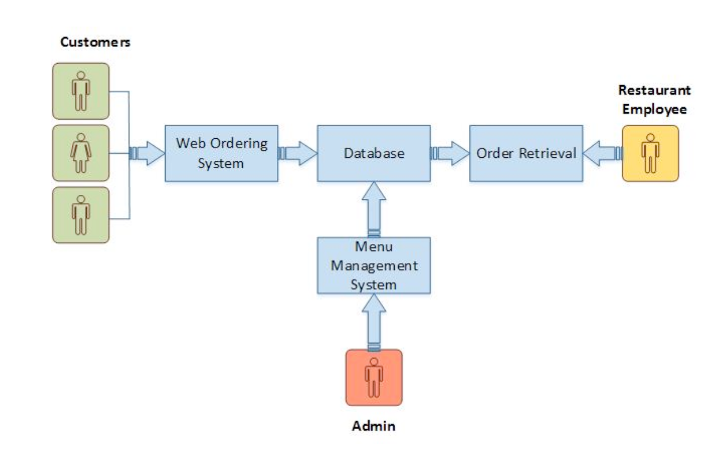
Problem architecture

Slide 17
Problem architecture
The structure of the system can be divided into 5 main logical components:
Web Ordering System –
Provides the functionality for customers to place their order and supply necessary details.
Menu Management –
Allows the restaurant to control what can be ordered by the customers.
Order Retrieval System –
Allows restaurant to keep track of all orders placed.
This component takes care of order retrieving and displaying order information.
Table Reservation System –
Provides the functionality for customers to book a table on a specific date and time.
Table Management -
Allows the restaurant to control and display the available and already reserved tables.

Slide 18
Algorithms For All Functionalities
Main Functionalities:
Food Ordering
Table Reservation
Rating and Feedback
Pre-requisites :
1. SignUp
2. LogIn

Slide 19
Algorithms For All Functionalities
SignUp :
Enter Website address (E.g. www.relish.in) on the address bar and click Enter.
In the homepage, Click on Signup.
Fill the form that appears next, along with a valid phone number and set a password.
Click Submit
IF the details are in the required format :
You will be redirected to the homepage ,
ELSE :
change the entries as specified and goto step 4.
After Successful Signup, You will be notified with a popup and redirected to homepage.

Slide 20
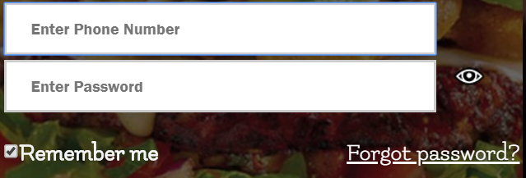
Algorithms For All Functionalities
2. LogIn :
Enter Website address (E.g. www.relish.in) on the address bar and click Enter.
In the homepage, Click on LogIn.
Enter your phone number and password.
Click Submit
IF the username exists in the database and matches with the password :
Login Successful, Redirect to Welcome page.
Else :
Wrong Password Alert ! ,
IF you remember password :
goto step 3.
Else :
Click on Forgot Password.

Slide 21
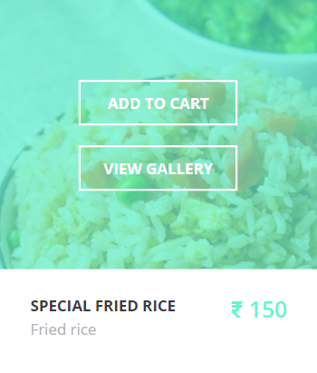
Algorithms For All Functionalities
3. Order Food : ( Pre-requisite : Login )
On the Welcome Page, Click on Order Food.
Select the items from those that are displayed and click on “ADD TO CART”.
Remove the items from the cart if not needed.
After successful selection, Click on Checkout.
It will redirect you to the billing page which displays the total cost incl. tax.
Select the address or Enter a new one.
Select Mode of Payment (ONLINE or OFFLINE ).
IF mode is ONLINE :
Select Bank and perform Payment.
ELSE :
Click On “PLACE MY ORDER” .

Slide 22

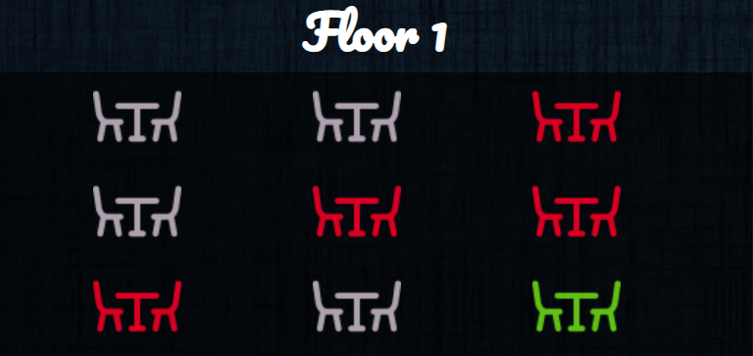


Algorithms For All Functionalities
4. Reserve Tables: ( Pre-requisite : Login )
On the Welcome Page, Click on Table Reservation.
Select the date and time from the list provided.
A webpage with the following table status will be shown:
Select from the available tables.
After successful selection, Click on Book Table.
You will be notified with the details, once the table is booked.
After successful completion, redirect to welcome page.
Available Tables
Reserved Tables
Selected Tables

Slide 23
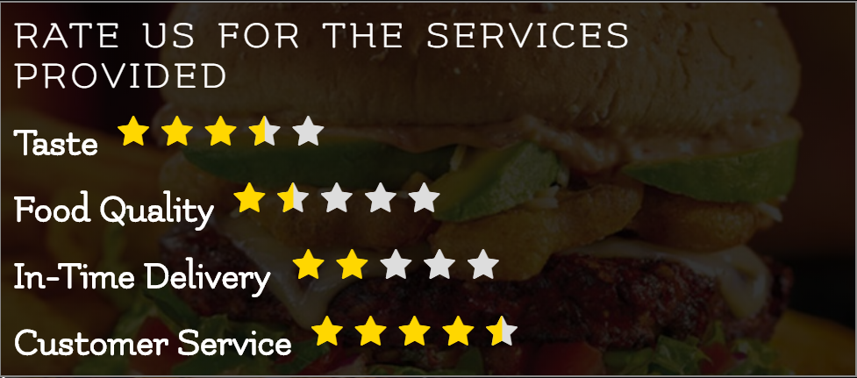
Algorithms For All Functionalities
5. Rating : ( Pre-requisite : Login )
On the Welcome Page, Click on “RATE US”.
Give the rating by selecting the stars for the parameter provided.
Click on Submit.
After successful completion, redirect to welcome page.

Slide 24

.
THANK YOU !

